Slide 1

Exam AZ-300: Microsoft Azure Architect Technologies Crash Course
Tim Warner

Slide 2


Tim Warner
Based in Nashville, TN, US
MCT, MVP
Twitter: @TechTrainerTim
Badge: timw.info/azarchcert

Slide 3
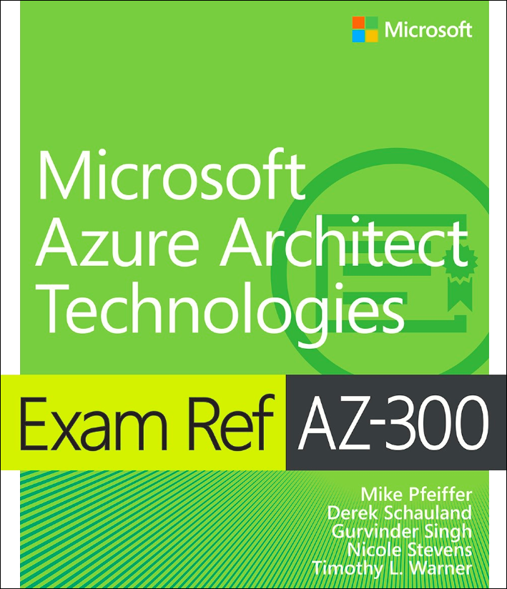
Tim Warner
timw.info/ms300
O’Reilly Online Learning

Slide 4
Course Materials
timw.info/az300

Slide 5
Session 1 of 2 Learning Goals
Introduction
Deploy and configure Azure infrastructure
Resource utilization
Storage accounts
VMs
Virtual networking
Azure AD

Slide 6
Session 2 of 2 Learning Goals
Azure migration
Serverless computing
Role-based access control
App deployment
Data security
Message-based architecture

Slide 7
Setting Expectations
Azure Architect is an expert-level certification
You should already know how to deploy and configure Azure resources
This is a "crash course"
Please plan to review these materials more than once
Five-minute break at midpoint
Please ask/answer questions and provide feedback in the Q/A panel, not the group chat

Slide 8
2020 Exam Update Information
Microsoft WorldWide Learning (WWL) revisits the Azure role-based certs yearly
Relevant blog post: timw.info/az2020
AZ-303 beta will be available ~ April 28, 2020
AZ-300 will remain in market 90 days after the beta launch

Slide 9
2020 Exam Update Strategy
You can earn your badge by combining the old and new exam versions:
AZ-300 and AZ-304
AZ-301 and AZ-301
The certification is the same, and has a 2-year expiry
If you’re already prepping for AZ-300, stay the course!
Beta sometimes takes a long time
Cert prep vendors need time to develop new materials

Slide 10
Tim's Certification Study Pyramid
Interdependence
Content knowledge
Practical application
Test-taking skills

Slide 11
Module 1: Deploy and Configure Azure Infrastructure

Slide 12
Storage Account Replication
1
3
3
2
LRS
ZRS

Slide 13
Storage Account Replication
1
3
1
3
2
2
GRS – RA/GRS

Slide 14
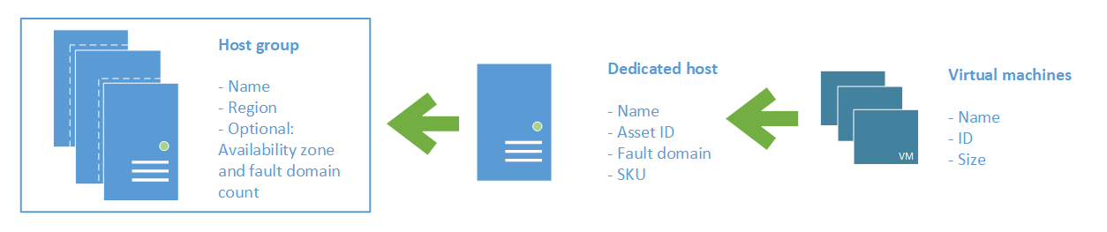
Azure VM Dedicated Host

Slide 15

Availability Set

Slide 16

Availability Zone

Slide 17

Hybrid Networking

Slide 18

VNet Peering

Slide 19

Network Virtual Appliance

Slide 20

Load Balancing

Slide 21

Azure Load Balancer

Slide 22

Application Gateway

Slide 23

Traffic Manager

Slide 24

Front Door Service

Slide 25

Hybrid Identity

Slide 26

Federated Identity

Slide 27
Module 2 Implement Azure Workloads and Security

Slide 28
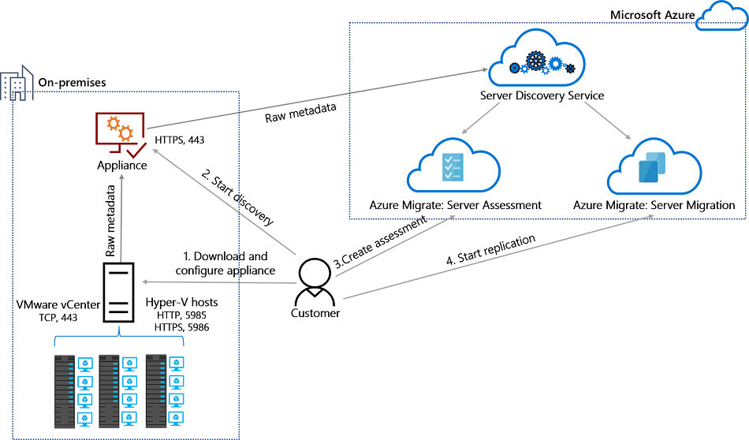
Azure Migrate

Slide 29
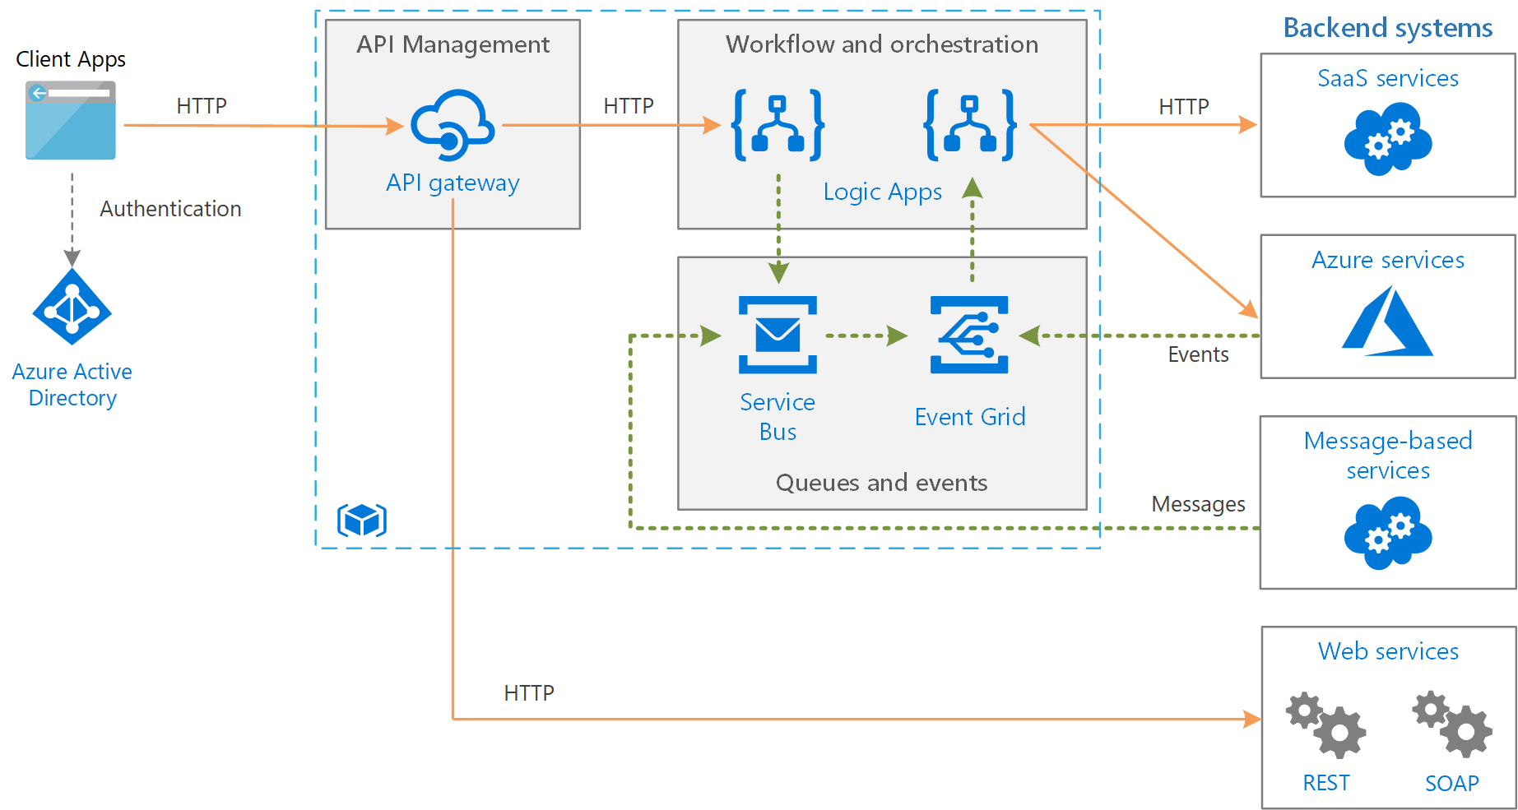
Message-Based Architecture

Slide 30

Azure Management Scopes
/ Tenant Root

Slide 31
Module 3: Create and Deploy Apps in Azure

Slide 32


Docker Container Lifecycle
https://timw.info/3635f

Slide 33
Module 4: Implement Authentication and Secure Data in Azure

Slide 34
Hybrid Identity

Slide 35
Federated Identity

Slide 36

Passthrough Authentication

Slide 37

Seamless Single Sign-on

Slide 38

Always Encrypted

Slide 39
Module 5: Develop for the Cloud and for Azure Storage

Slide 40

VM Scale Sets

Slide 41
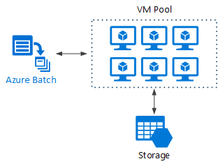
Azure Batch

Slide 42
Module 6: Exam AZ-300 Exam Strategy

Slide 43
Module 6 Learning Objectives
Grasp the content
Acquire the hands-on skills
Master computer-based testing
Comprehend what to expect before, during, and after the exam

Slide 44
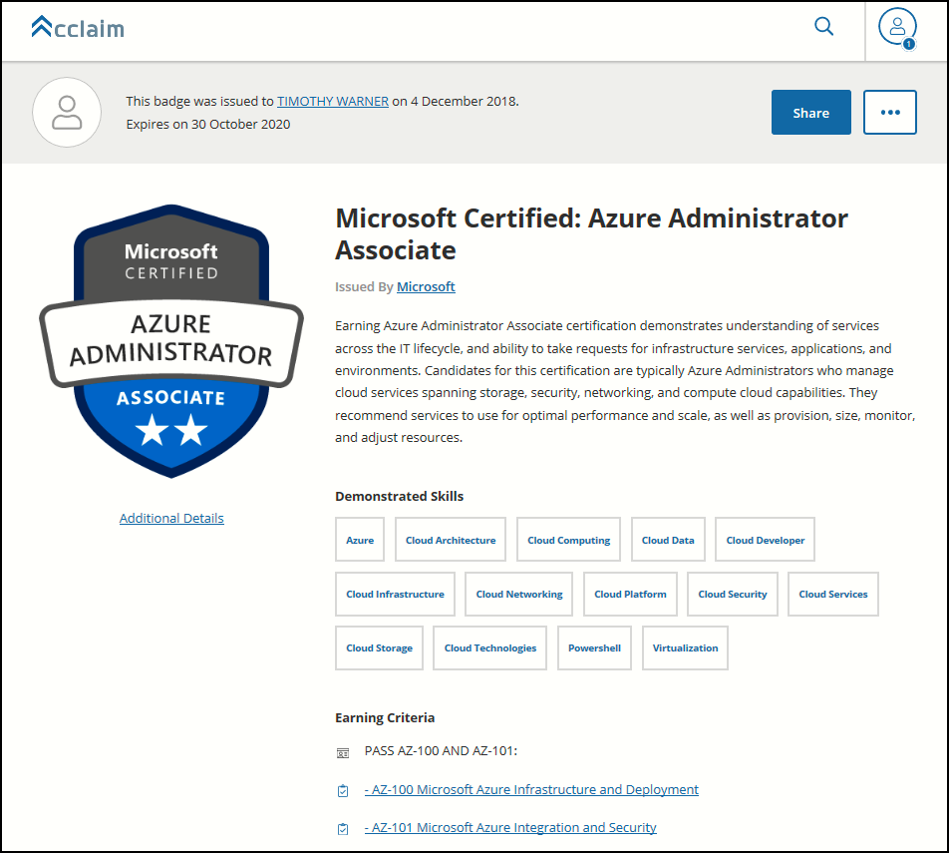
Digital Credentials by Credly/Acclaim

Slide 45
Exam AZ-300 Item Types

Slide 46

Multiple Choice

Slide 47
Repeated Scenario
You need to move an Azure VM to another hardware host.
Solution: You redeploy the VM.
Does this solution meet the goal?
Yes
No

Slide 48

Select and Place

Slide 49

Build List and Reorder

Slide 50

Active Screen/Fill in the Blank

Slide 51

Case Study

Slide 52






Performance-Based Lab

Slide 53
AZ-300 Exam Tips
ARM API suggestion:
60 percent Azure portal
20 percent Azure PowerShell
10 percent Azure CLI
10 percent KQL
Expect to see lots and lots and lots of JSON
Performance-based labs
Open a second tab for shell.azure.com
Don't be afraid to file an item challenge/grievance

Slide 54
Thank you!
Course materials: timw.info/az300
Twitter: @TechTrainerTim
Work: timw.info/ps
Web: TechTrainerTim.com

